Slide 1
Primary Sources
Accessing online & via Waitaki District Libraries & Archive

Slide 2
What do you think primary sources are?
Letters, diaries, newspapers, photographs, videos, physical artefacts etc

Slide 3
http://schools.natlib.govt.nz/ resources-learning/primary-sources/primary-sources- what-are-they

Slide 4
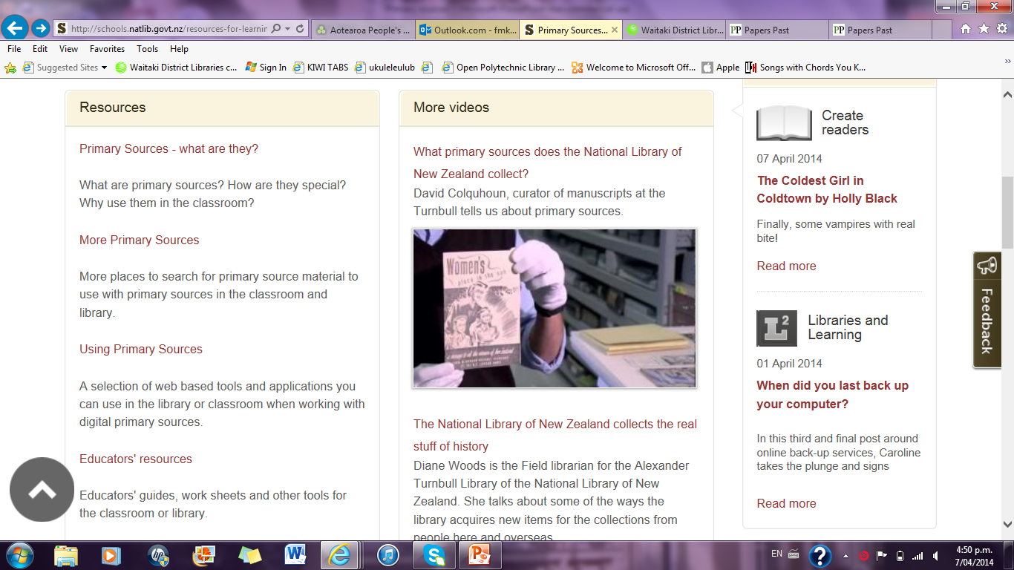

Slide 6
Finding Primary Sources
http://schools.natlib. govt.nz/ information/students

Slide 7
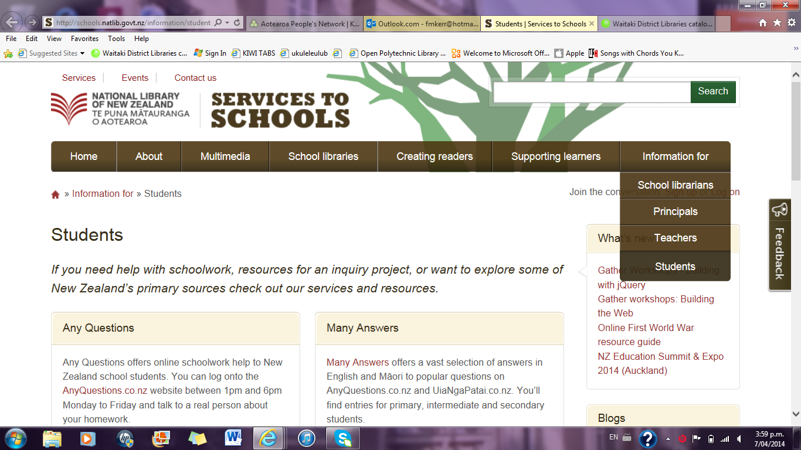

Slide 8
Many Answers
http://www. manyanswers.co.nz/

Slide 9
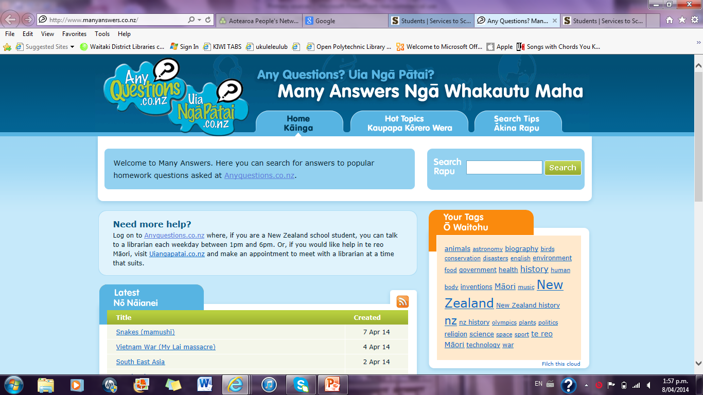

Slide 10
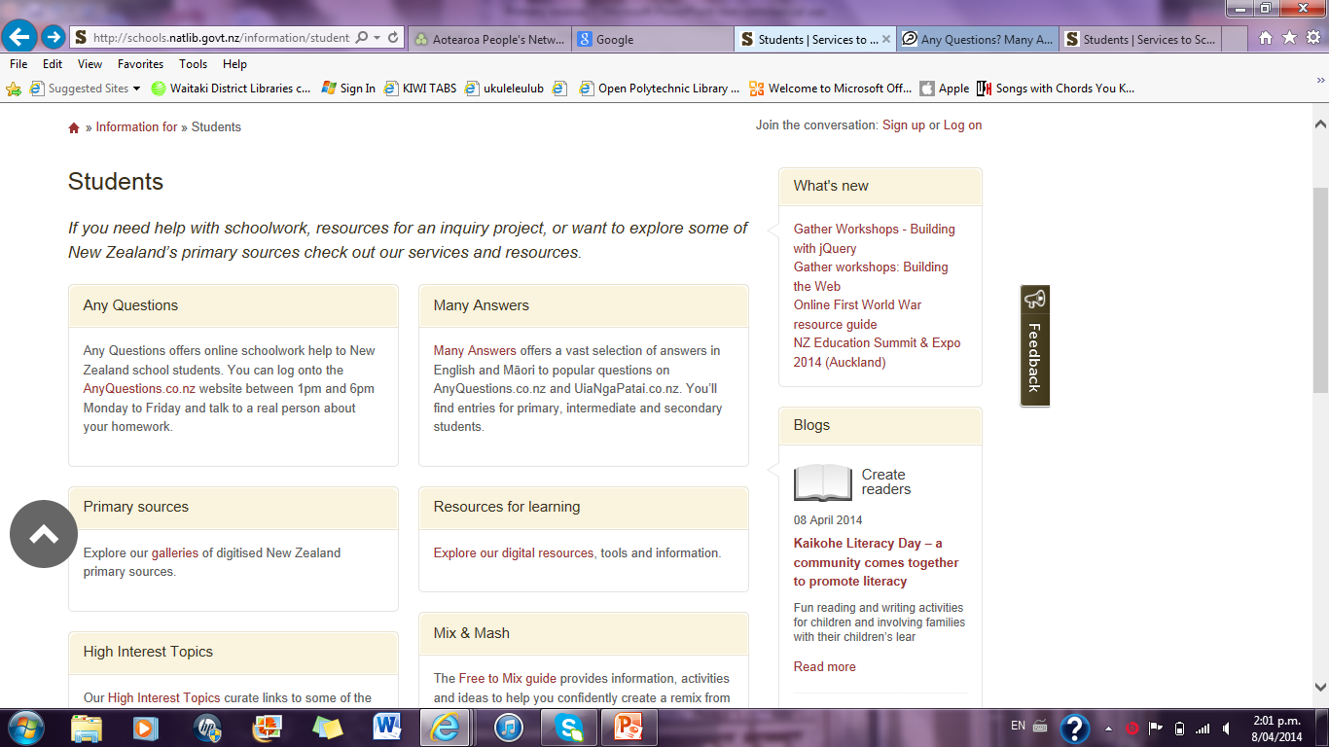

Slide 11
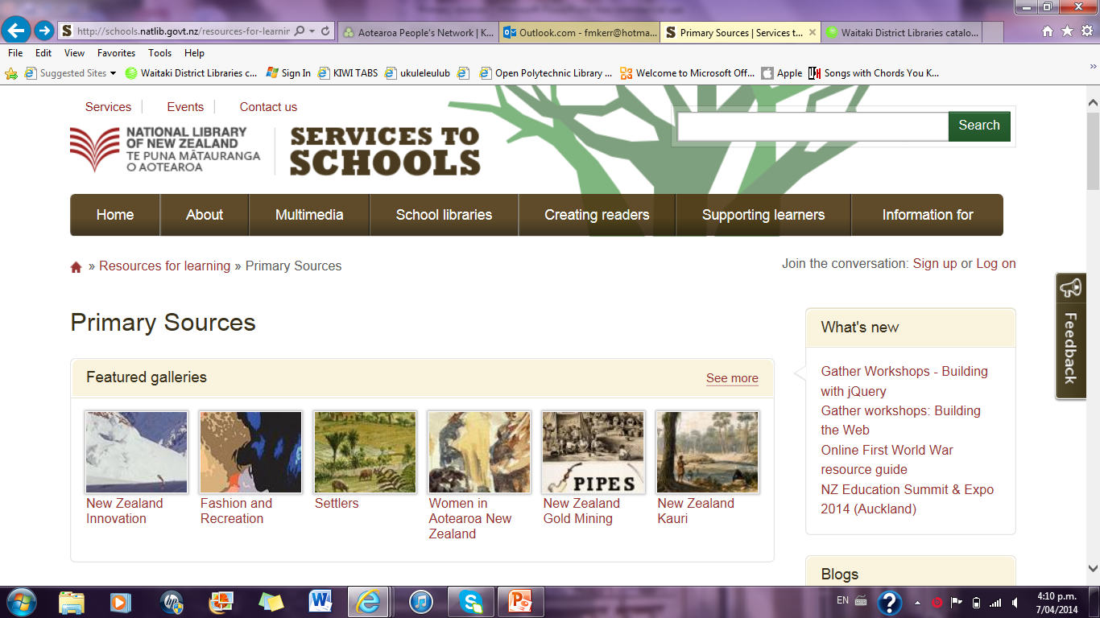

Slide 12
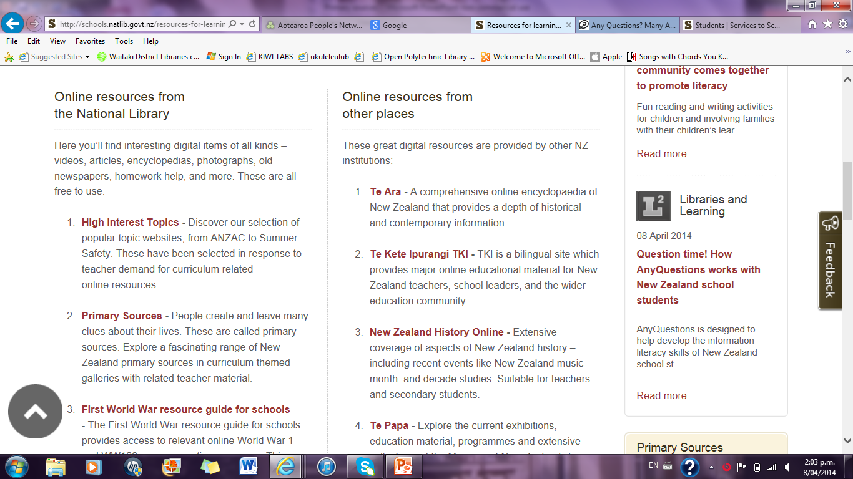

Slide 13
Papers Past
http://paperspast. natlib.govt.nz

Slide 14
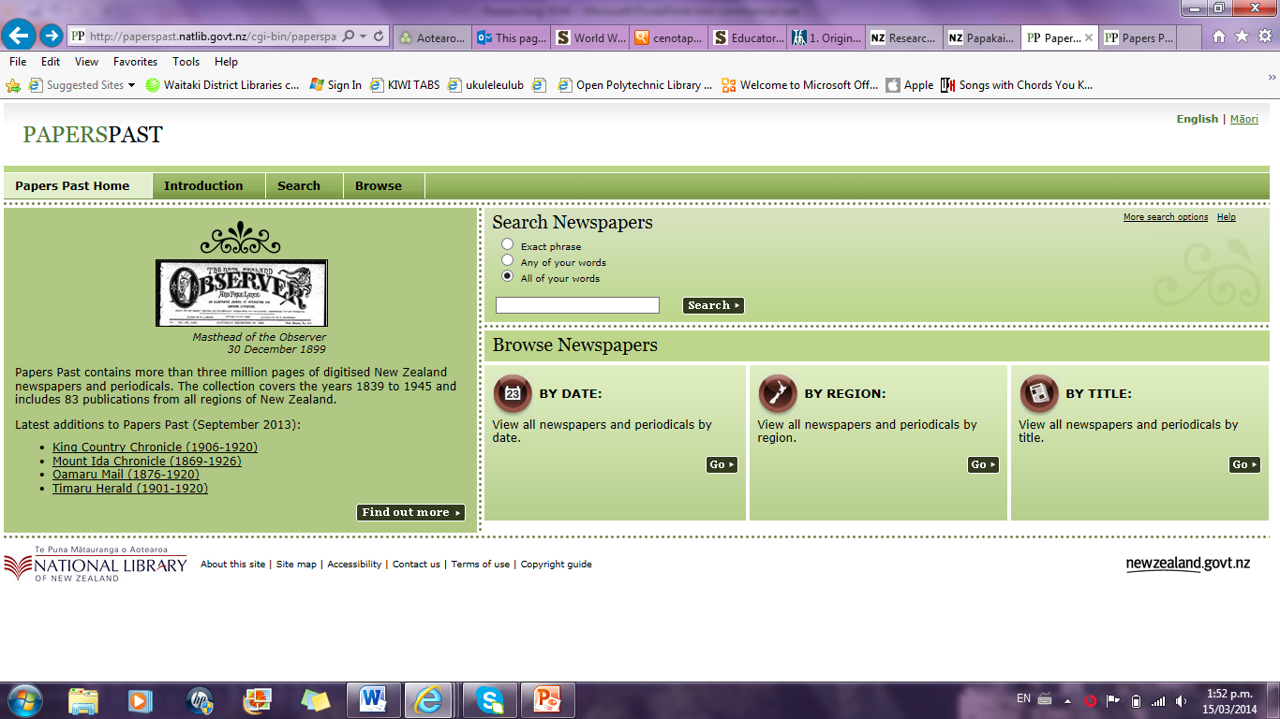

Slide 15
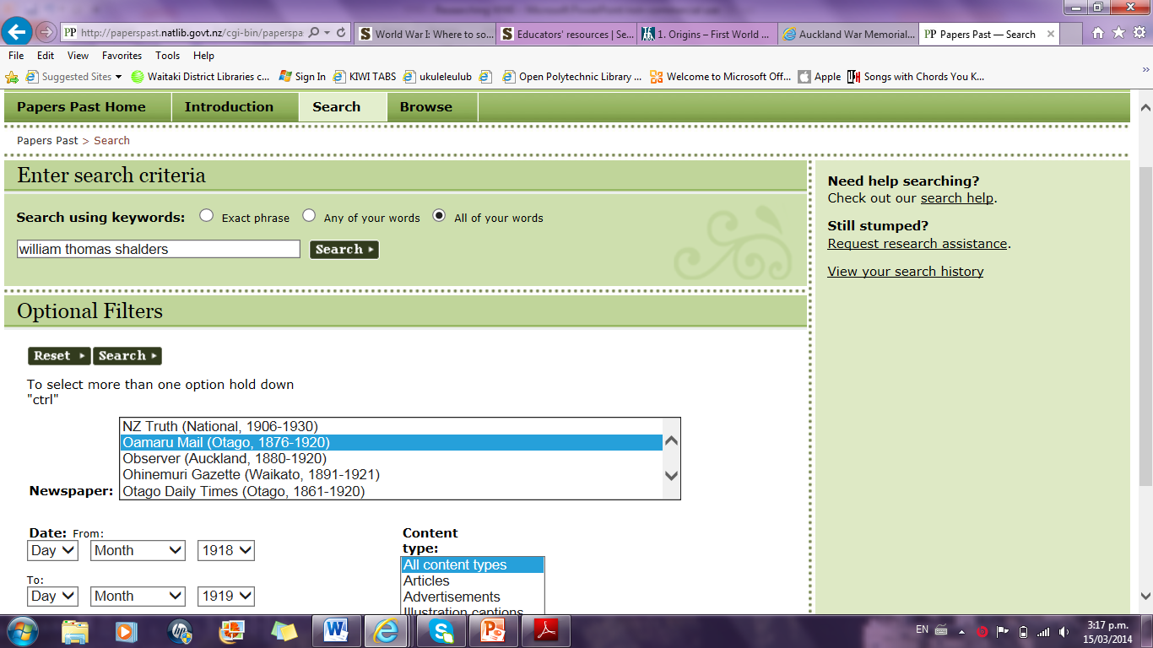

Slide 16
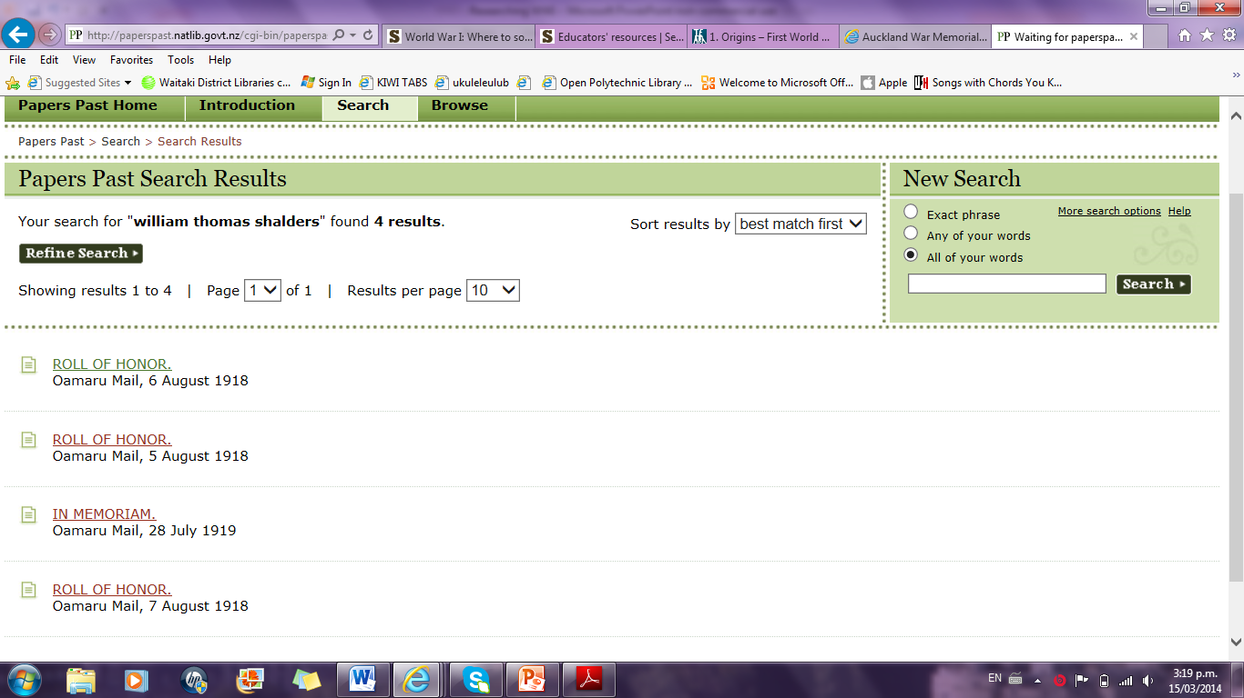

Slide 17
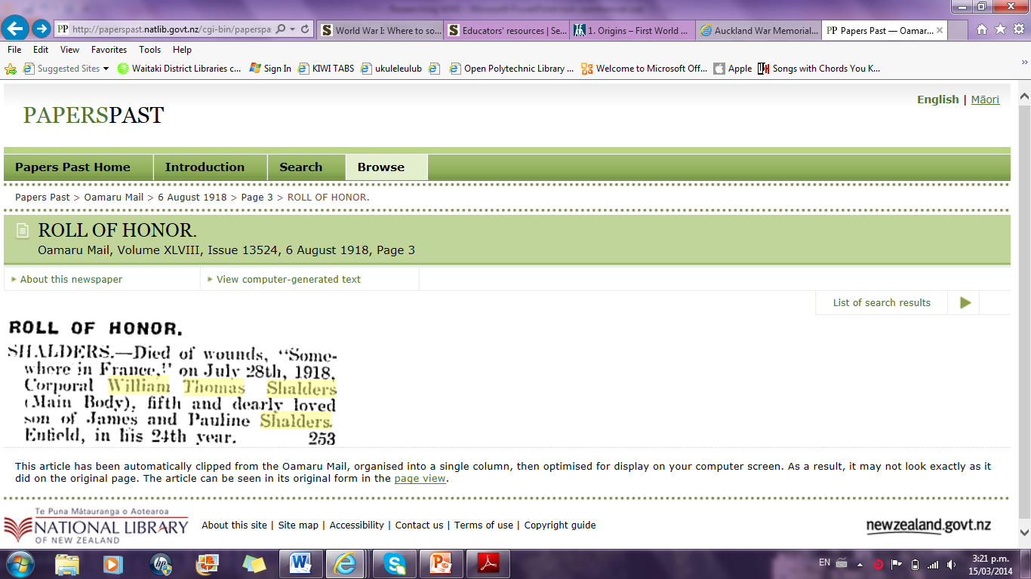

Slide 19
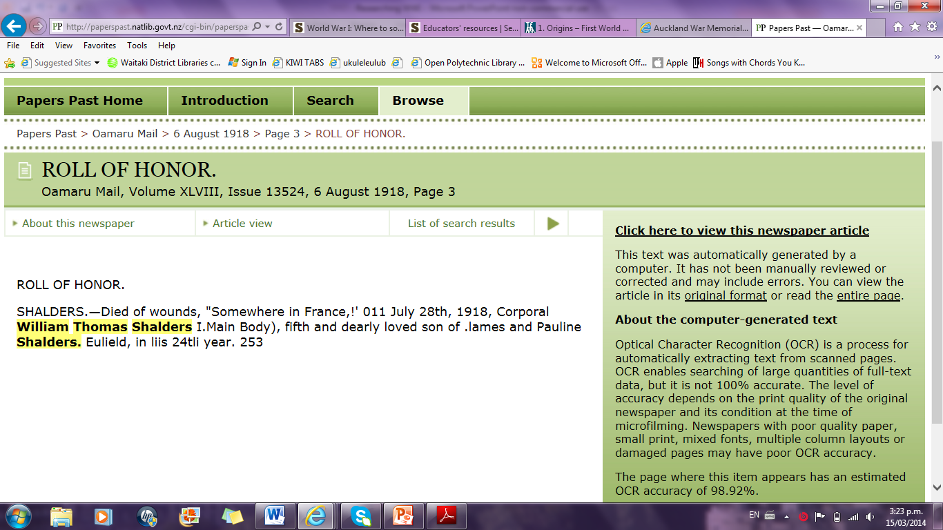

Slide 20
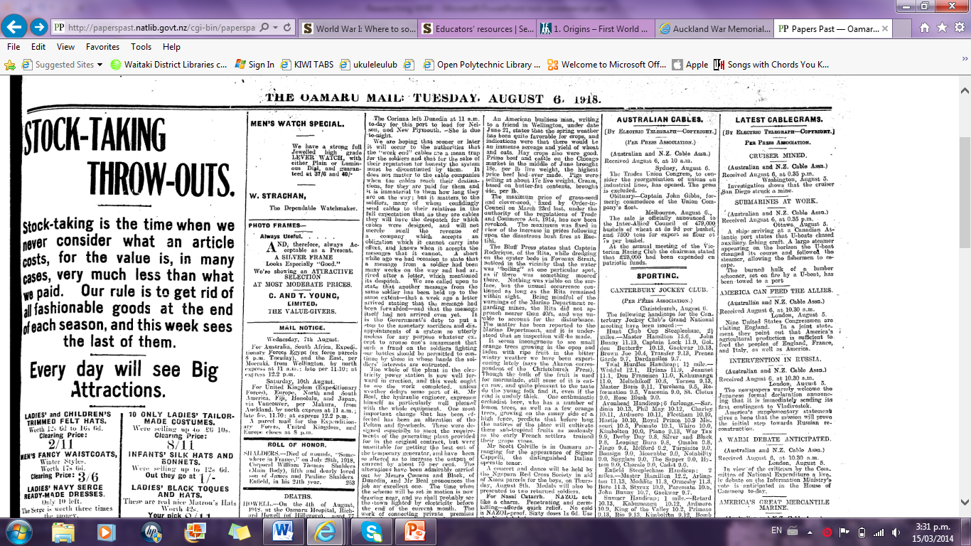

Slide 21
Digital NZ
http://www. digitalnz.org/

Slide 22
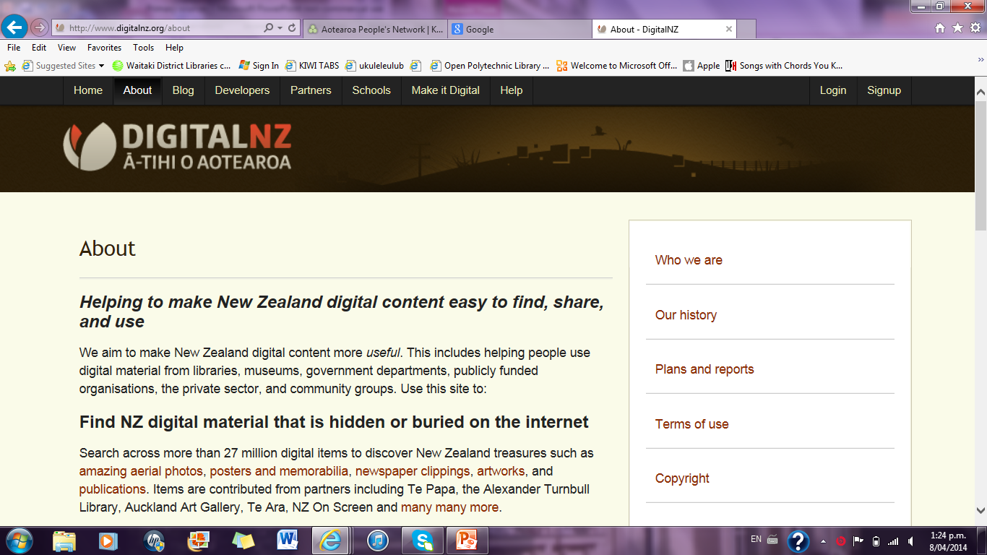

Slide 23
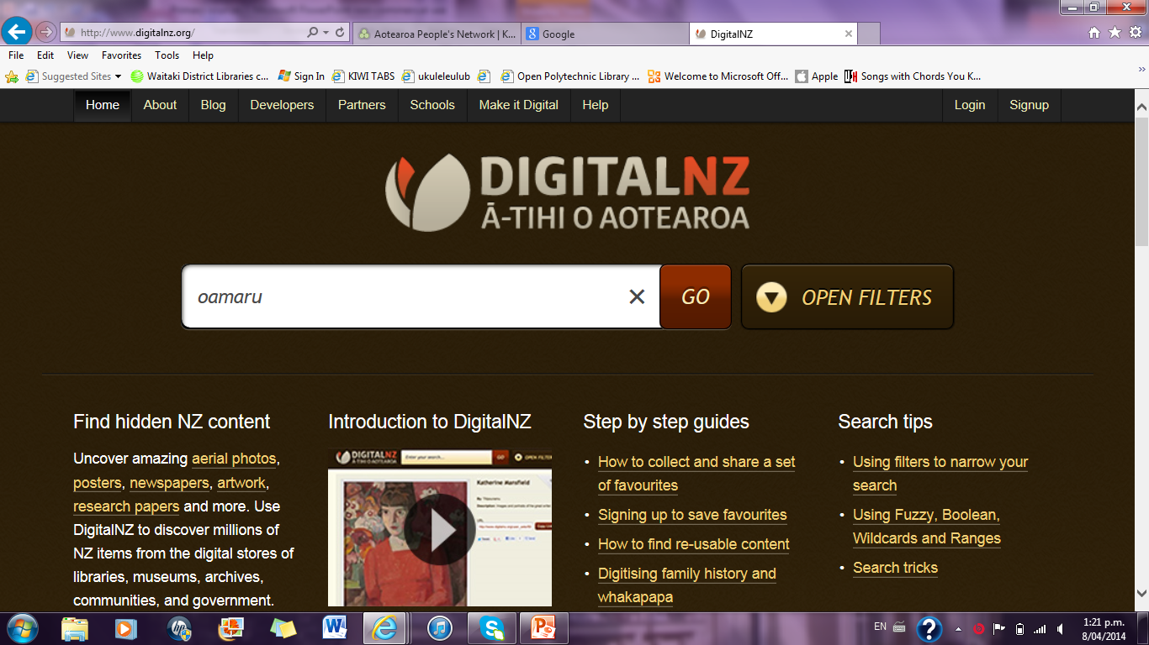

Slide 24
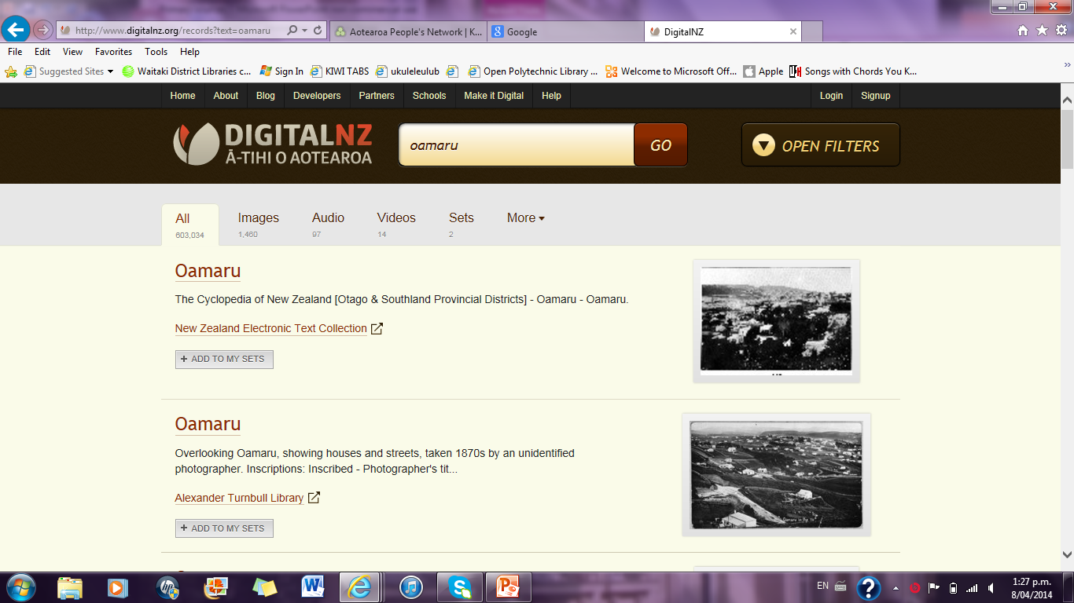

Slide 25
Primary Sources at the Archive: details on handout

