Slide 1
LOOKING FOR INFORMATION ON A TOPIC IN BOOKS
www.library. waitaki.govt.nz

Slide 2
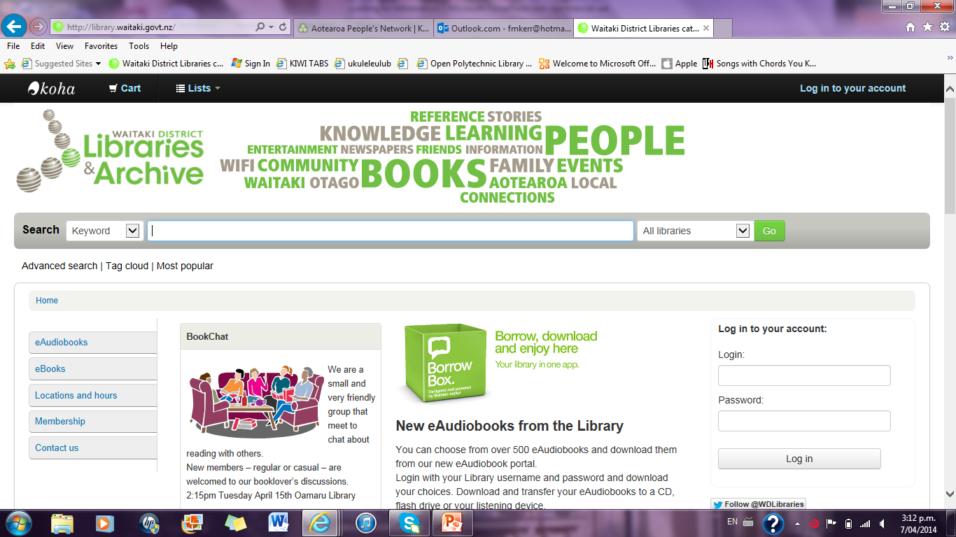

Slide 3
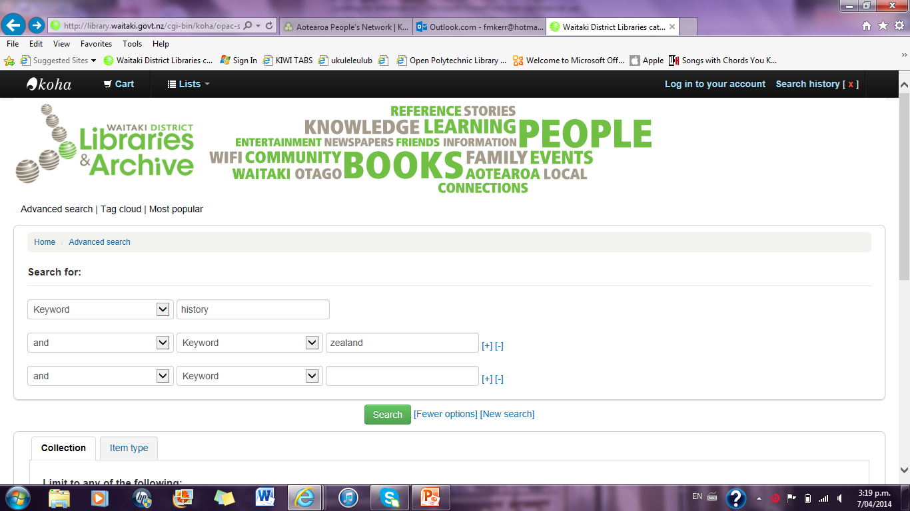

Slide 4
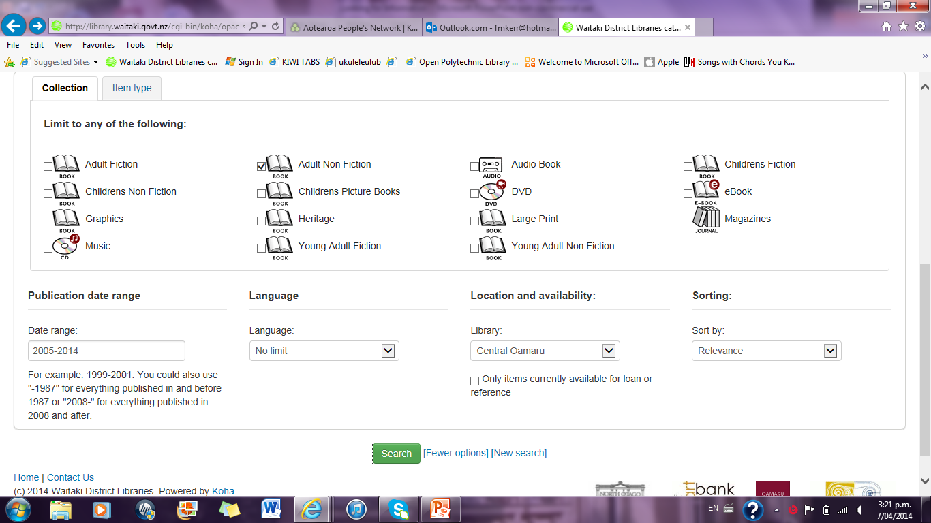

Slide 5
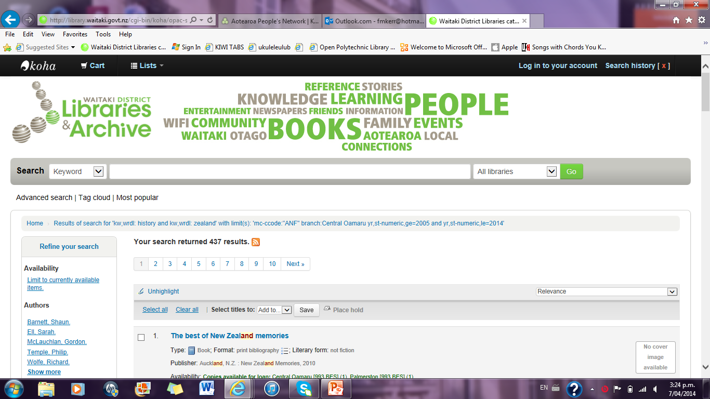

Slide 6
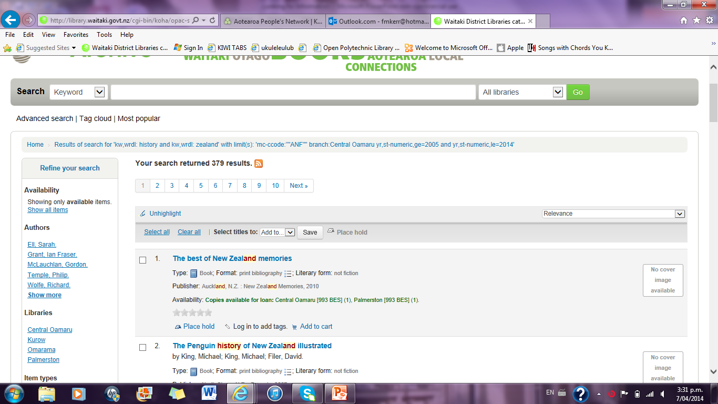

Slide 7
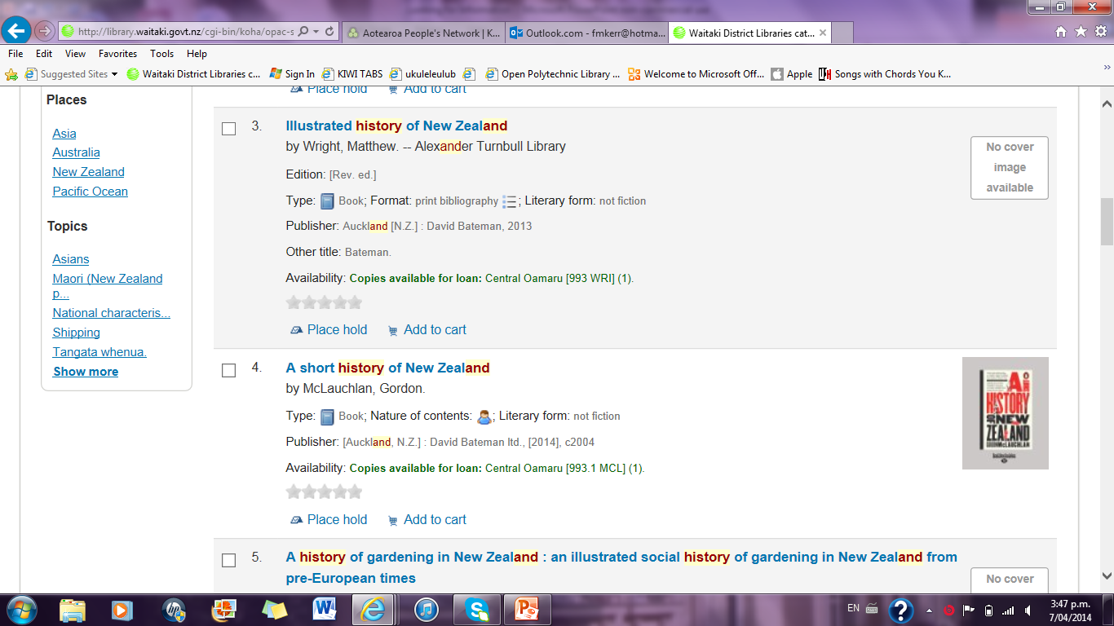

Slide 8
